Slide 1
Paragraph tag

Slide 2
Agenda
Paragraph tag
Sample output
Paragraph tag implementation

Slide 3
Paragraph tag
Paragraph tags are used to break the text into paragraphs.
Syntax
<p> Your paragraph 1 here</p>
<p> Your paragraph 2 here</p>
…..

Slide 4
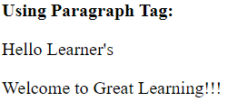

Sample output

Slide 5
Paragraph tag implementation
Let’s see implementation of paragraph tag.

Slide 6
Summary
Paragraph tags are used to write text in paragraphs.
We have seen implementation of paragraph tag.
DO NOT WRITE ANYTHING
HERE. LEAVE THIS SPACE FOR
WEBCAM

Slide 7
Thank You
Proprietary content. ©Great Learning. All Rights Reserved. Unauthorized use or distribution prohibited

